Slide 1
Computer Architecture Concepts
Part 23 – Jumps and Subroutines

Slide 2
Objectives
Look at how jump instructions can be used to allow subroutines in RISC-V Assembly language

Slide 3
Jump
So far, our programs run each instruction in sequential order until the end of the program
Program counter (PC) stores address of instruction to execute next
Default move to next instruction in sequence
RISC-V is byte addressed and the instruction is 4 bytes, so the address would increase by 4 each time
Jump allows us to move control to another part of the program by explicitly setting the PC to a particular address
We use a label in Assembly language when we want the assembler to substitute the address

Slide 4
Subroutine
Similar to procedures / functions / methods in High level languages
Allow Blocks of code/functionality to be reused
Might need to call the same subroutine in multiple places
Putting code into subroutine means only one location to maintain/update
Makes code easier to read

Slide 5
Subroutine
Program control needs to jump to start of subroutine
Use a label that will indicate the address of the first instruction in the subroutine
When the code in the subroutine has finished control needs to go back to where it would have been
Return address stored in a register (ra)

Slide 6
Jump Instructions
Jump and link (jal)
Pseudo instruction
Store the program counter in register ra
It will do that automatically when we use jal
Jump to statement at address given by label
Example, if printHeader is a label in the .text part of program
jal printHeader
To return we use ret to jump to address given in register ra

Slide 7
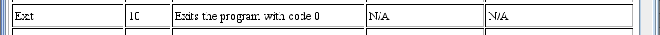
Using a subroutine in a program
We want the code in the subroutine to only run when we jump to it with a jal instruction
We must make sure that the program will finish and not run the subroutine code again at the end
Use syscall number 10 to exit a program, that is stop it from running
addi a7, zero, 10
ecall

Slide 8
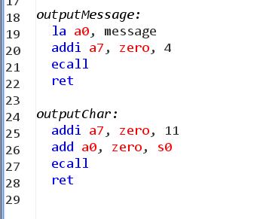
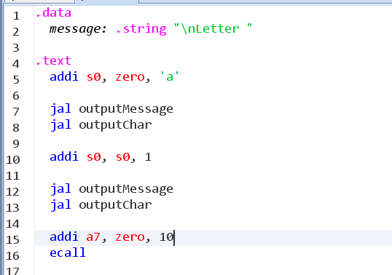
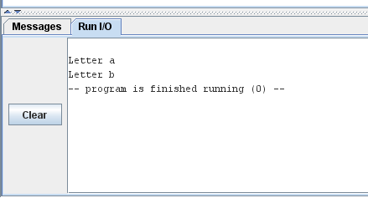
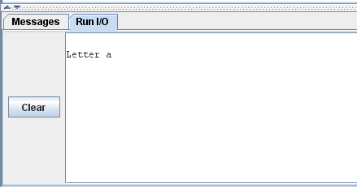
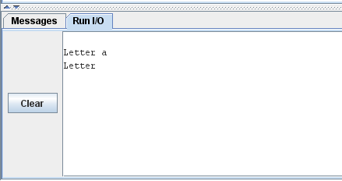


Example

Slide 9
Summary
We have looked at the simplest subroutines in RISC-V assembly language
Use jal with a label to jump to the subroutine
It will automatically store the return address in register ra
Use ret to return to the address stored in register ra
Use ecall 10 to exit the program so that the subroutine doesn’t run again
We have not looked at
Passing parameters to a subroutine
Allowing a subroutine to call another subroutine

